Slide 1

Input and Output Stream
CCS0023/L
Object Oriented Programming (Java)

Slide 2
10
LESSON #10
Input and Output Stream
Input and Output Stream

Slide 3
Java I/O
Java I/O (Input and Output) is used to process the input and produce the output.
Java uses the concept of a stream to make I/O operation fast. The java.io package contains all the classes required for input and output operations.
We can perform file handling in Java by Java I/O API.
Input and Output Stream

Slide 4
Stream
A stream is a sequence of data. In Java, a stream is composed of bytes. It's called a stream because it is like a stream of water that continues to flow.
In Java, 3 streams are created for us automatically. All these streams are attached with the console.
1) System.out: standard output stream
2) System.in: standard input stream
3) System.err: standard error stream
Input and Output Stream

Slide 5
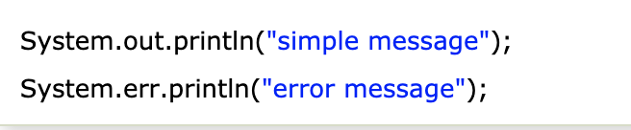
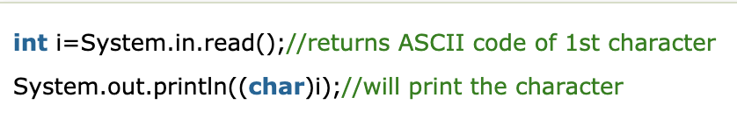
Stream
Let's see the code to print output and an error message to the console.
Let's see the code to get input from console.
Input and Output Stream

Slide 6
OutputStream vs InputStream
OutputStream
Java application uses an output stream to write data to a destination; it may be a file, an array, peripheral device or socket.
InputStream
Java application uses an input stream to read data from a source; it may be a file, an array, peripheral device or socket.
Input and Output Stream

Slide 7
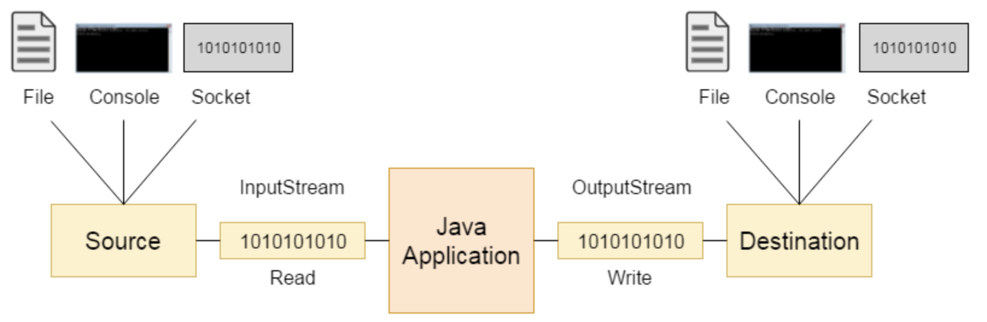
OutputStream vs InputStream
Input and Output Stream

Slide 8
OutputStream Class
OutputStream Class
Java OutputStream class is an abstract class. It is the superclass of all classes representing an output stream of bytes. An output stream accepts output bytes and sends them to some sink.
Input and Output Stream

Slide 9
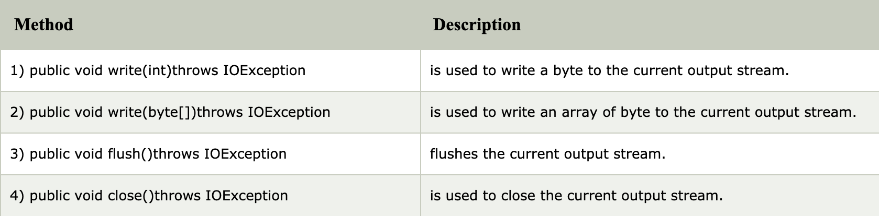
OutputStream Class
Useful methods of OutputStream Class
Input and Output Stream

Slide 10
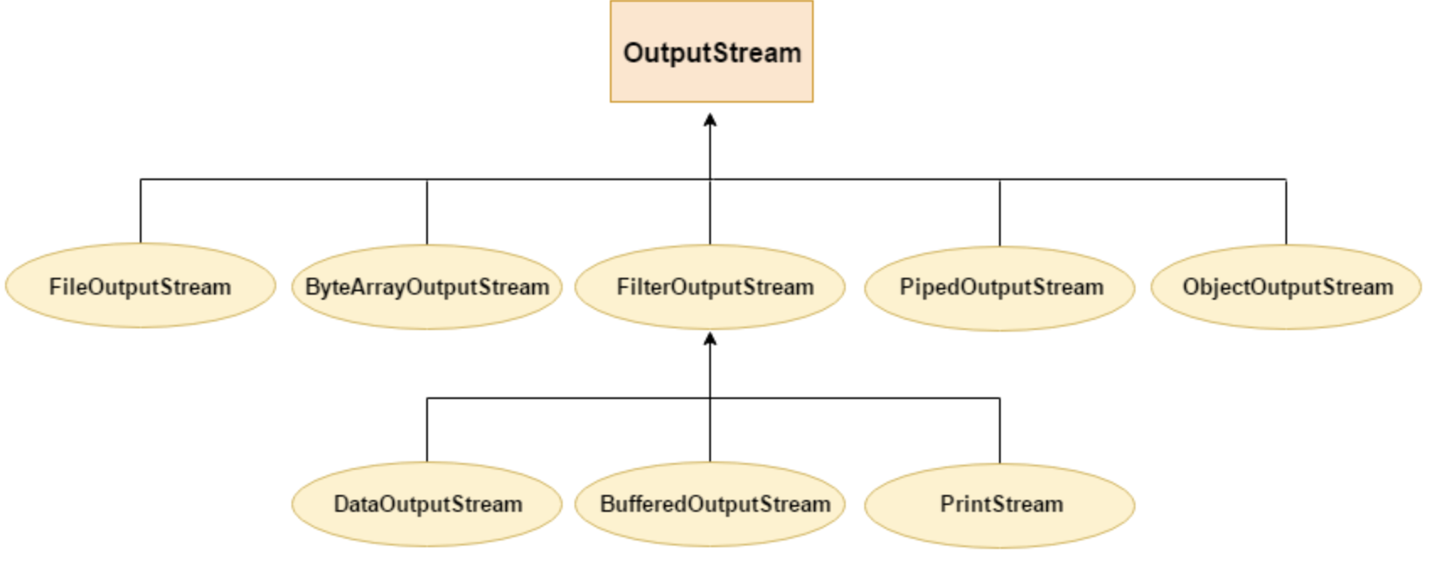
OutputStream Class
OutputStream Hierarchy
Input and Output Stream

Slide 11
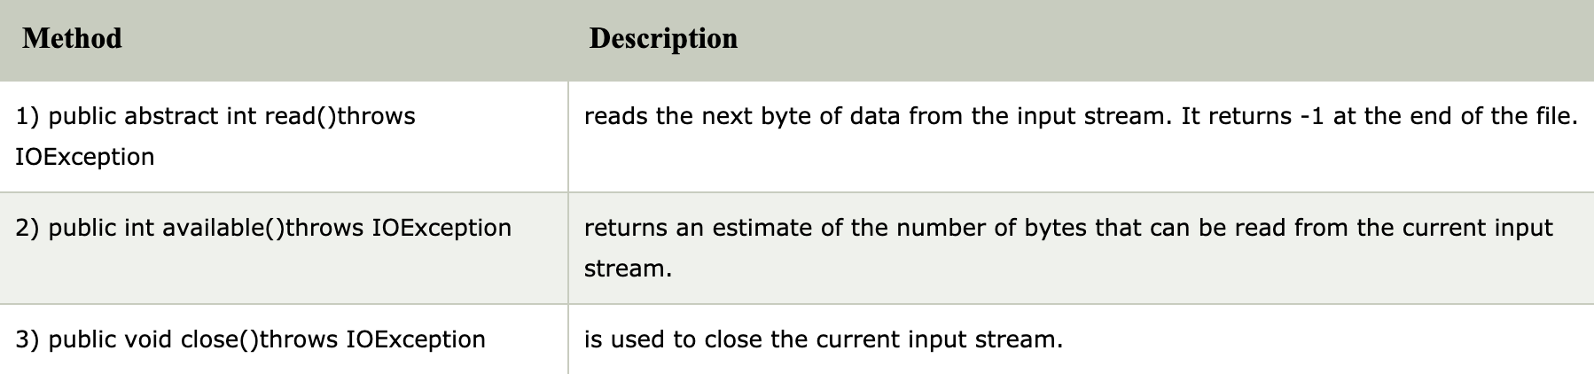
InputStream Class
InputStream class is an abstract class. It is the superclass of all classes representing an input stream of bytes.
Useful methods of InputStream
Input and Output Stream

Slide 12
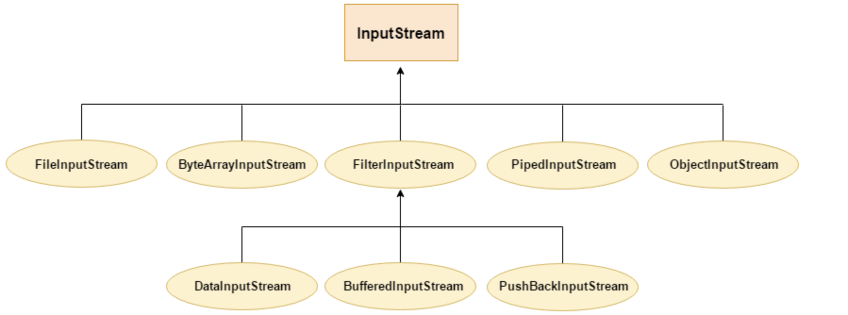
InputStream Class
InputStream Hierarchy
Input and Output Stream

Slide 13
Java FileOutputStream Class
Java FileOutputStream is an output stream used for writing data to a file.
If you have to write primitive values into a file, use FileOutputStream class. You can write byte-oriented as well as character-oriented data through FileOutputStream class. But, for character-oriented data, it is preferred to use FileWriter than FileOutputStream.
FileOutputStream class declaration for Java.io.FileOutputStream class:
Input and Output Stream

Slide 14
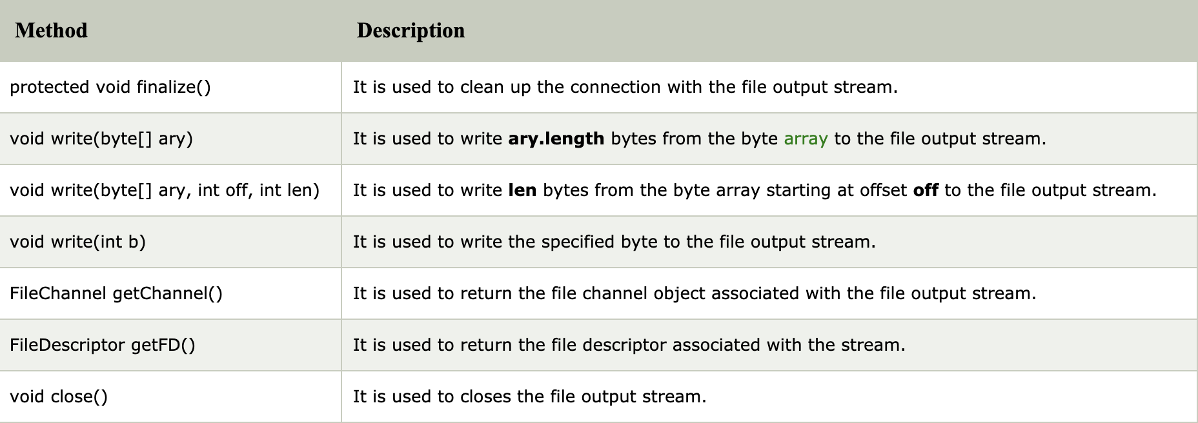
FileOutputStream class methods
Input and Output Stream

Slide 15
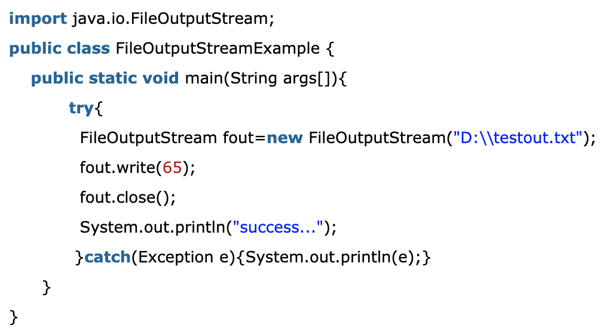

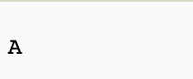
Java FileOutputStream Example 1: write byte
Output:
The content of a text file testout.txt is set with the data A.
testout.txt
Input and Output Stream

Slide 16
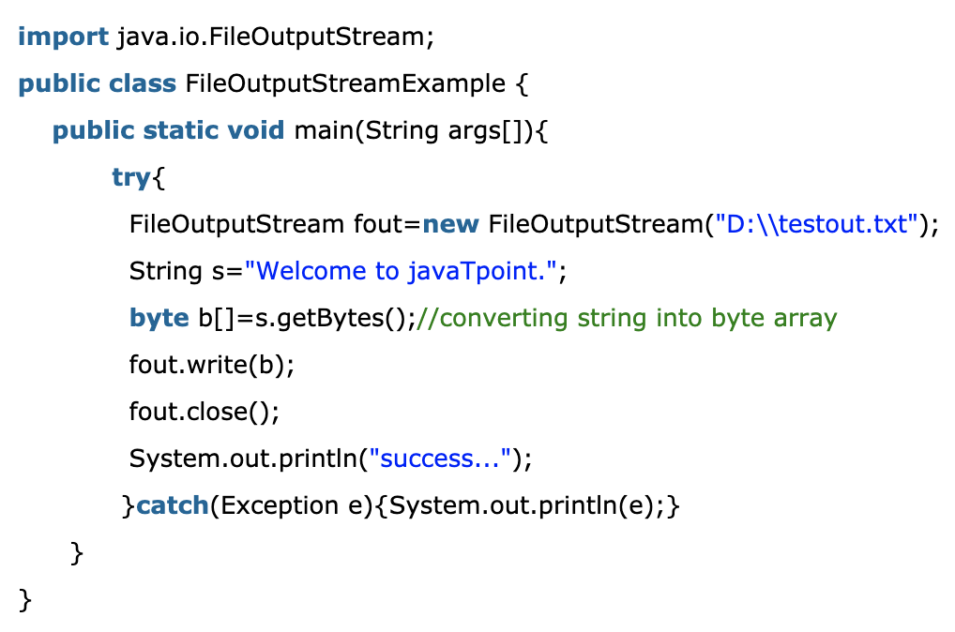
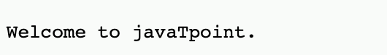
Java FileOutputStream Example 2: write string
Output:
The content of a text file testout.txt is set with the data Welcome to javaTpoint.
testout.txt
Input and Output Stream

Slide 17

Java FileInputStream Class
Java FileInputStream class obtains input bytes from a file. It is used for reading byte-oriented data (streams of raw bytes) such as image data, audio, video etc. You can also read character-stream data. But, for reading streams of characters, it is recommended to use FileReader class.
FileOutputStream class declaration for Java.io.FileInputStream class:
Input and Output Stream

Slide 18
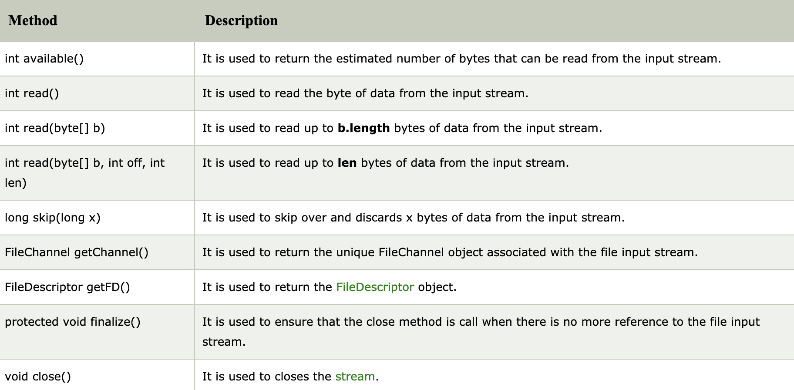
Java FileInputStream class methods
Input and Output Stream

Slide 19
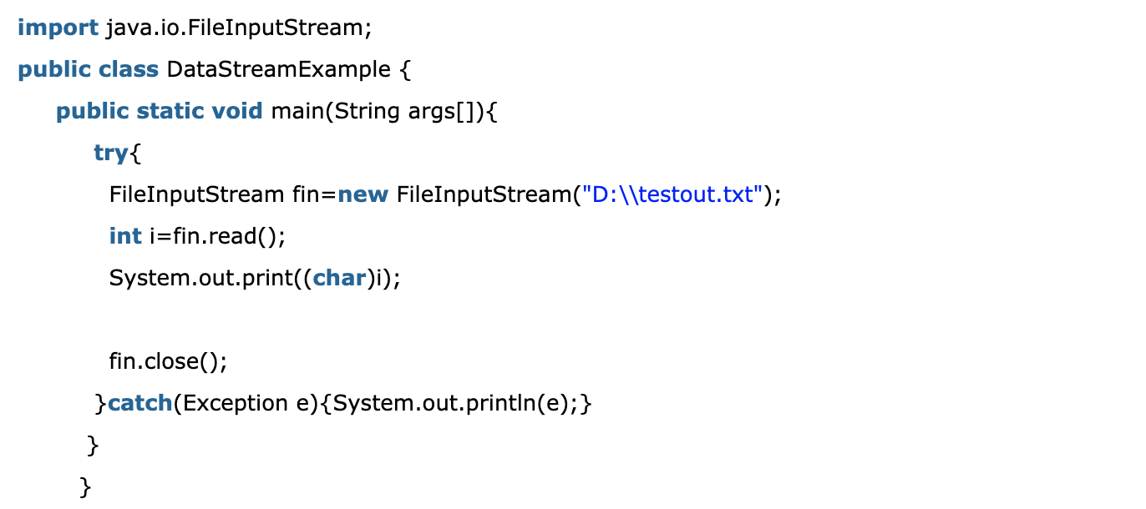
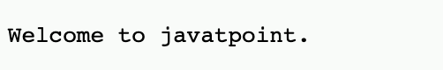

Java FileInputStream example 1: read single character
Note: Before running the code, a text file named as "testout.txt" is required to be created. In this file, we are having following content:
After executing the above program, you will get a single character from the file which is 87 (in byte form). To see the text, you need to convert it into character.
Output:
Input and Output Stream

Slide 20
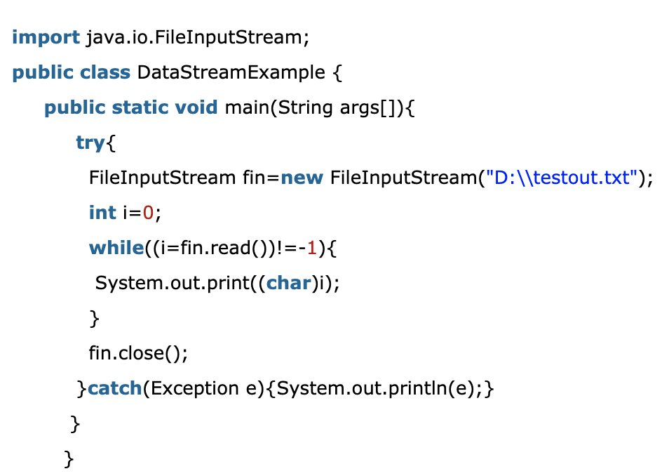
Java FileInputStream example 2: read all characters
Output:
Input and Output Stream

Slide 21
Java FileWriter Class
Java FileWriter class is used to write character-oriented data to a file. It is character-oriented class which is used for file handling in java.
Unlike FileOutputStream class, you don't need to convert string into byte array because it provides method to write string directly.
Java.io.FileWriter
Input and Output Stream

Slide 22
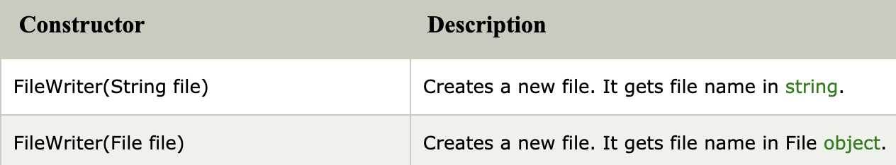
Java FileWriter Class
Constructors of FileWriter class
Input and Output Stream

Slide 23
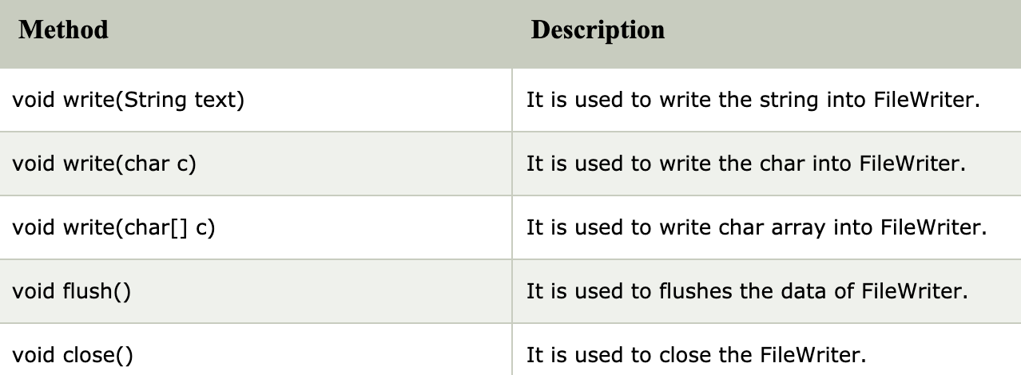
Java FileWriter Class
Methods of FileWriter class
Input and Output Stream

Slide 24
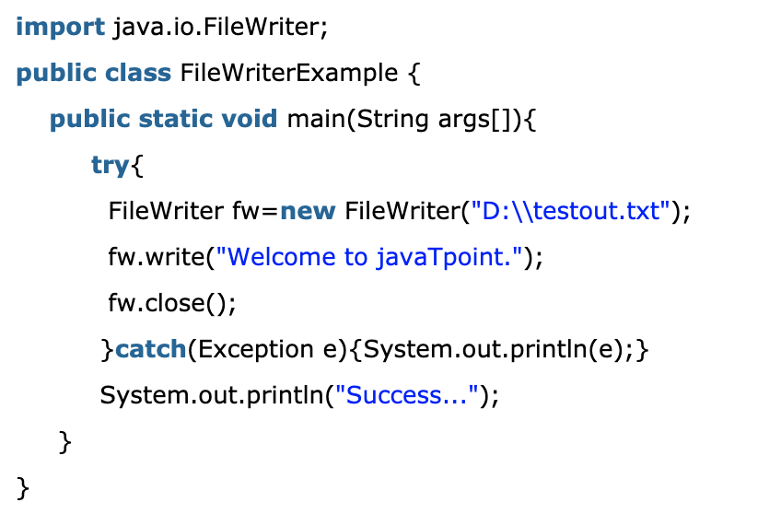
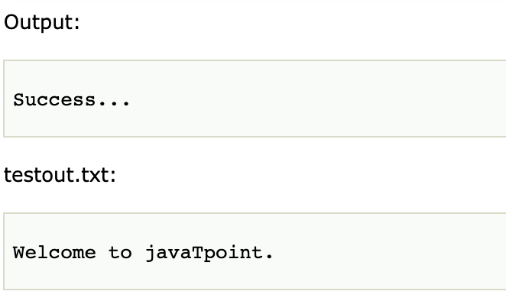
Java FileWriter Example
In this example, we are writing the data in the file testout.txt using Java FileWriter class.
Input and Output Stream

Slide 25
Java FileReader Class
Java FileReader class is used to read data from the file. It returns data in byte format like FileInputStream class.
It is character-oriented class which is used for file handling in java.
Java.io.FileReader
Input and Output Stream

Slide 26
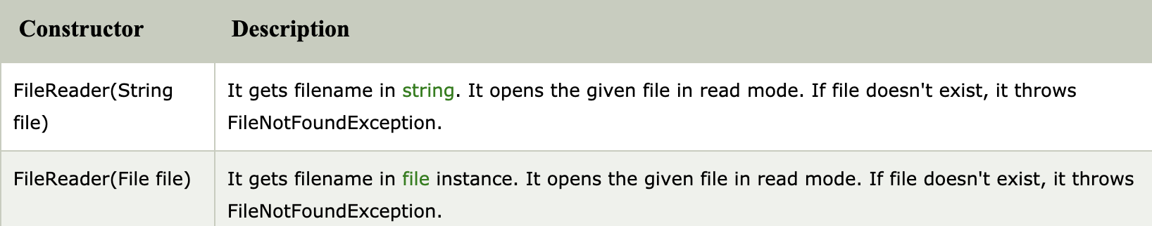
Java FileReader Class
Constructors of FileReader class
Input and Output Stream

Slide 27
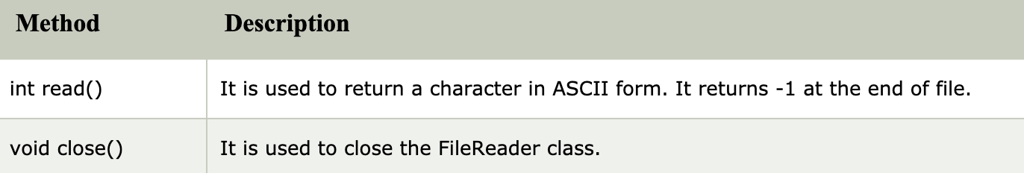
Java FileReader Class
Methods of FileReader class
Input and Output Stream

Slide 28
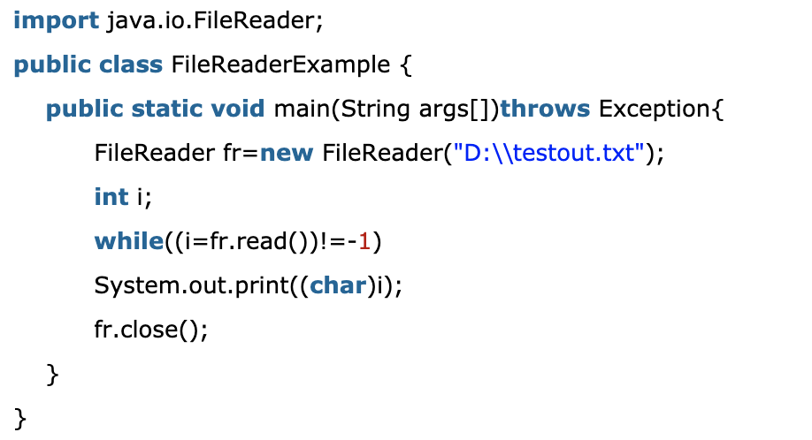
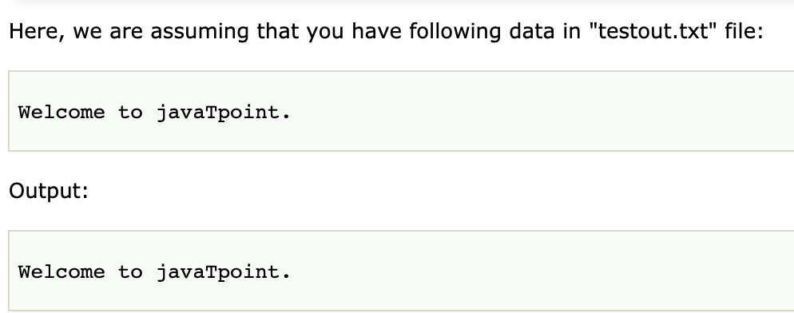
Java FileReader Example
In this example, we are reading the data from the text file testout.txt using Java FileReader class.
Input and Output Stream

